Slide 1
Student and Financial Aid Focus for Banner 9
Notes:
This deck goes over what is good to know about Banner 9 for Student and Financial Aid professionals.

Slide 2
Benefits of Banner 9
Improved user experience
  Modern, yet familiar, web user interface with standard controls
  Shorter learning curve for occasional users
  Enhanced usability and navigation for power users
  Ability to run in any modern browser
Significant reduction in time & cost to maintain Banner
  Ellucian Solution Manager
    Simplifies the upgrade process
    Minimizes system interruptions and risk
    Reduces time and cost for installation and deployment
    Less user testing required
  Modifications replaced with configurations and extensions – eliminates maintenance with upgrades, reduces testing required

Slide 3
Benefits of Banner 9
Improved Student and Faculty Experience
  Student Advising Profile – saves times for students and advisors, enables personalized advice for better academic decisions
  Attendance tracking empowers faculty, saving time for registrars and financial aid
  Faculty Grade Entry streamlines grade processing including the ability to enter grades via spreadsheet
  Registration
    More intuitive, saving time for registrar and the IT office
    Seamless integration with Ellucian DegreeWorks
    Enables advisors to better plan their student’s success
    Better visibility into course demand for registrars

Slide 4
Benefits of Banner 9
Self Service modules reduce administrative burden
  Employee Profile provides more self-service information for employees saving time for HR
  Position Description saves time in creation, editing, routing and approval of positions and makes posting to job search sites faster and more efficient
  Direct Deposit for staff and students reduces manual effort for employees, students and internal staff
  Purchase Requisition delivers faster procurement or products and services, saving time for the business office
  My Finance Query reduces reporting burden, enables better financial management
  Communication Management enables simpler and more efficient communications in areas such as financial aid award letters, past-due tuition notices, registration reminders and more

Slide 5
What’s Available In Banner 9
Administrative Applications
Self-Service Applications
Banner General
Banner Student
Banner Human Resources
Banner Finance
Banner Financial Aid
Banner Student Aid
Banner Advancement
Banner Accounts Receivable
Student
Finance & HR
General
Registration
Student Advising Profile
Attendance Tracking
Faculty Grade Entry
Class Roster
Purchase Requisition
Direct Deposit
My Finance Query
Employee Profile
Position Description
Effort Reporting
Labor Redistribution
Communication Management
Personal Information
Notes:
Banner 8 administrative applications move to Sustaining Support January 1, 2019, so institutions should make them a priority.
Banner 8 self-service applications continue to be supported in 2019

Slide 6

The Student Experience
With Banner 9…
Impact to Students
Integrated academic plan and registration
Decreased time to graduation resulting in lower student debt
Mobile experience for increased engagement
Institutional information meets students where they are
Streamlined support processes
More quality time with advisor – less time spent gathering information

Slide 7

The Faculty Member Experience
With Banner 9…
Impact to Faculty Member
Holistic student profile
More connected to students and aware of situational issues
Simplified grade entry and attendance tracking
Time savings to focus on teaching and learning
Composite employee profile
Streamlined procedures make it easy to work for the institution

Slide 8
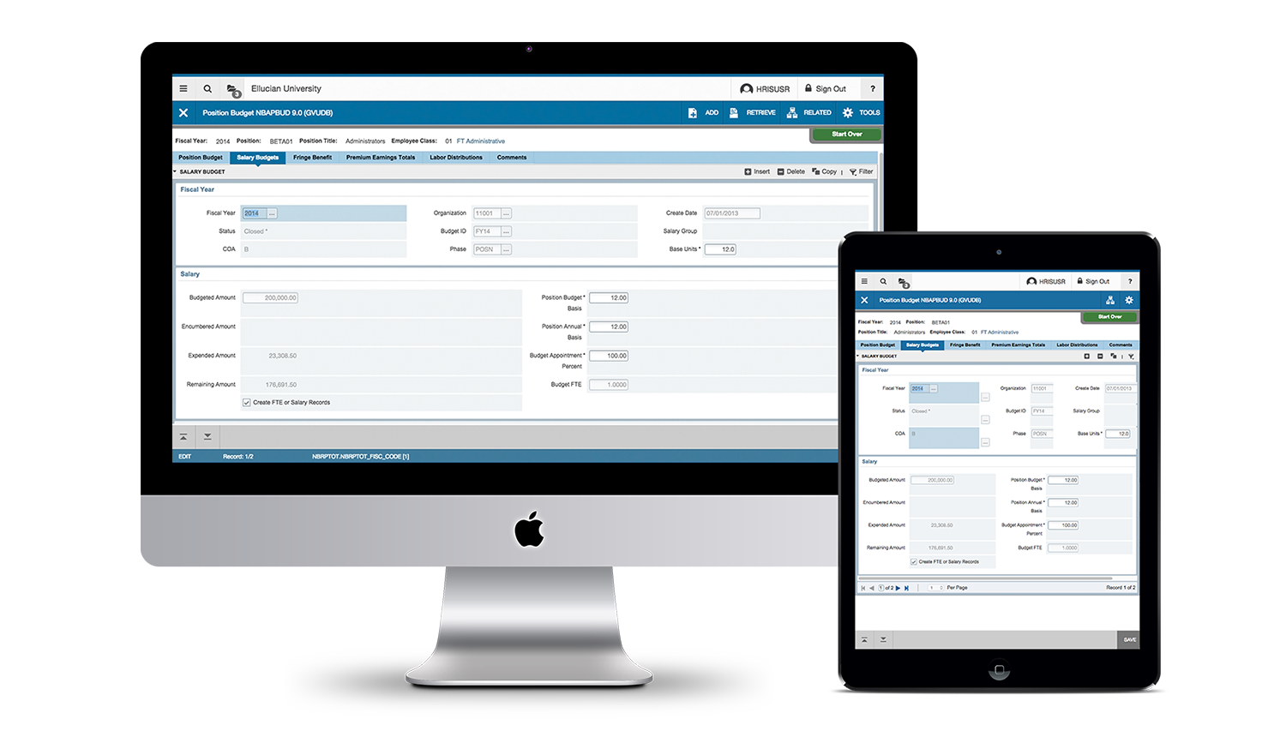

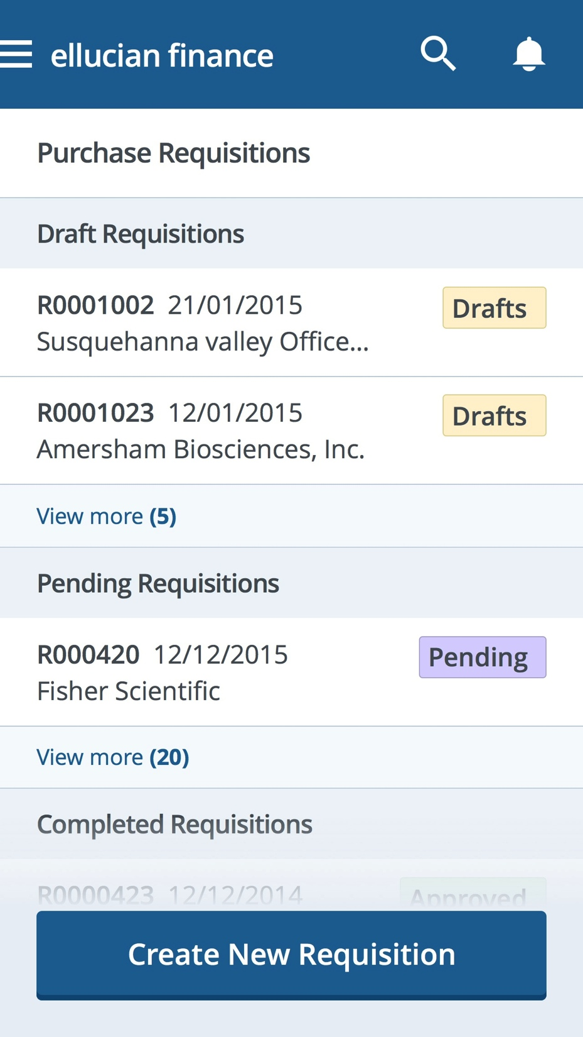
Banner 9’s New Look & Feel

Slide 9
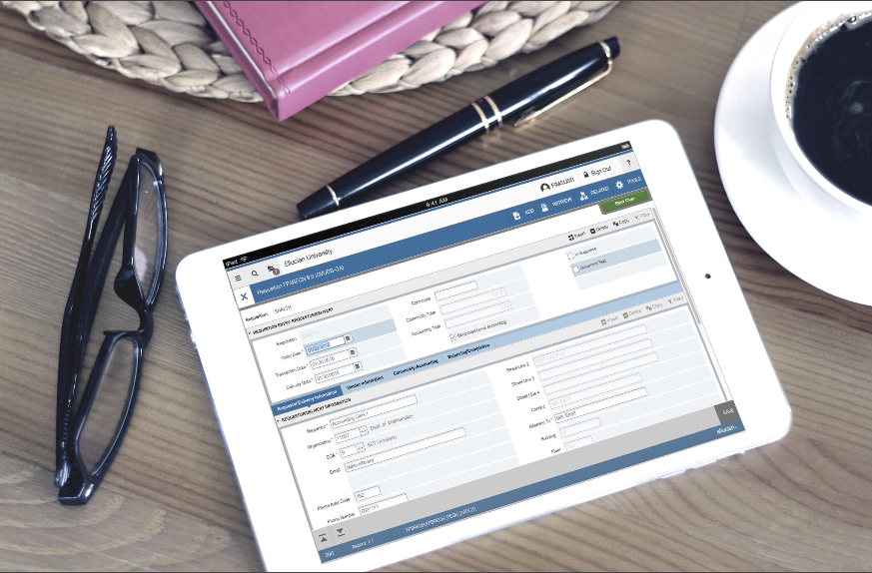
Tablet Friendly: Banner on-the-go

Slide 10
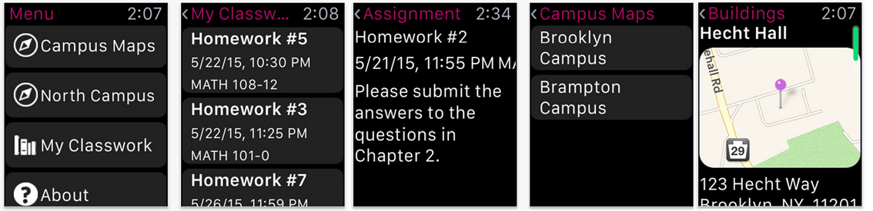


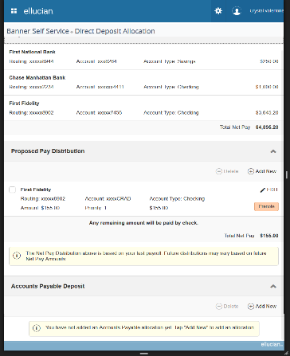
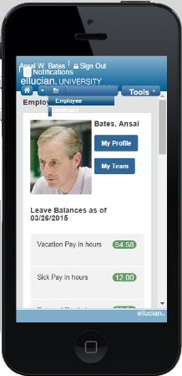
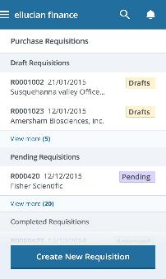
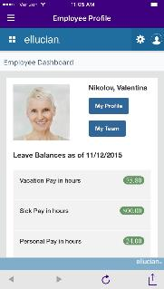
Supporting Constituents On The Go With All Devices
Ellucian Solutions Incorporate Mobility and Web 2.0 into administrative systems architecture
Watches
Tablets
Phones

Slide 11
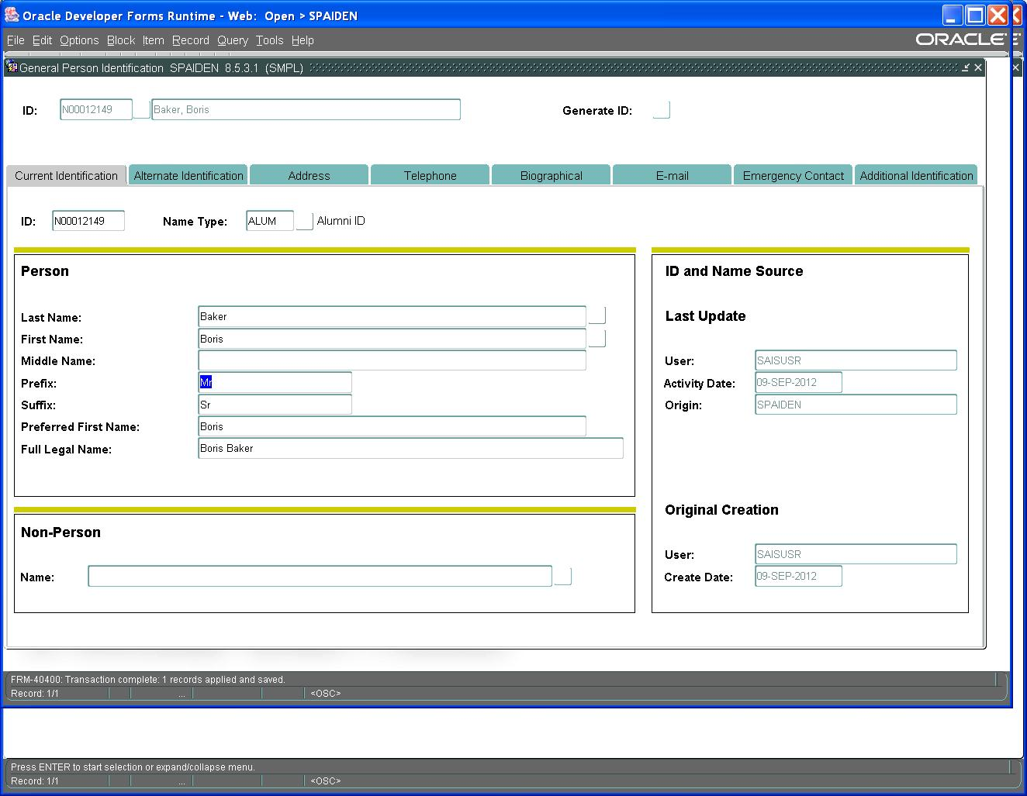
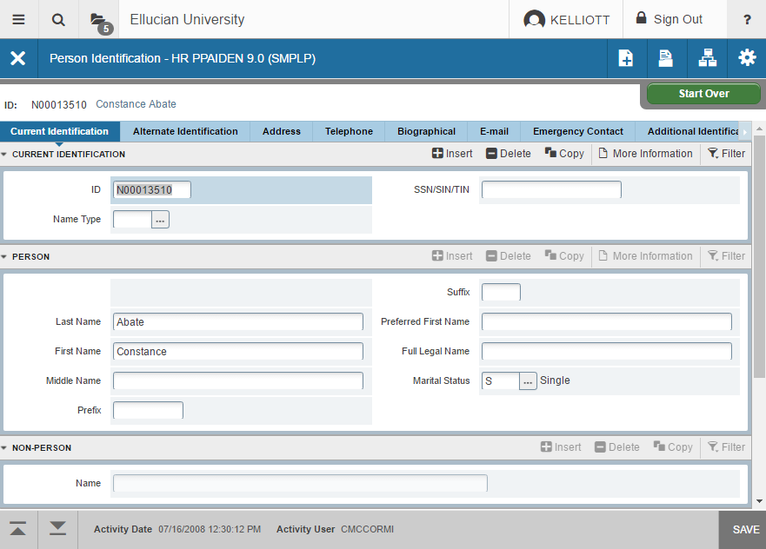
Release 9 Administrative Improvements
Old Oracle Forms
New Admin Transformed Page
Notes:
You can see the dramatic difference between how our Old Forms based on Oracle look versus the Transformed Pages.

Slide 12
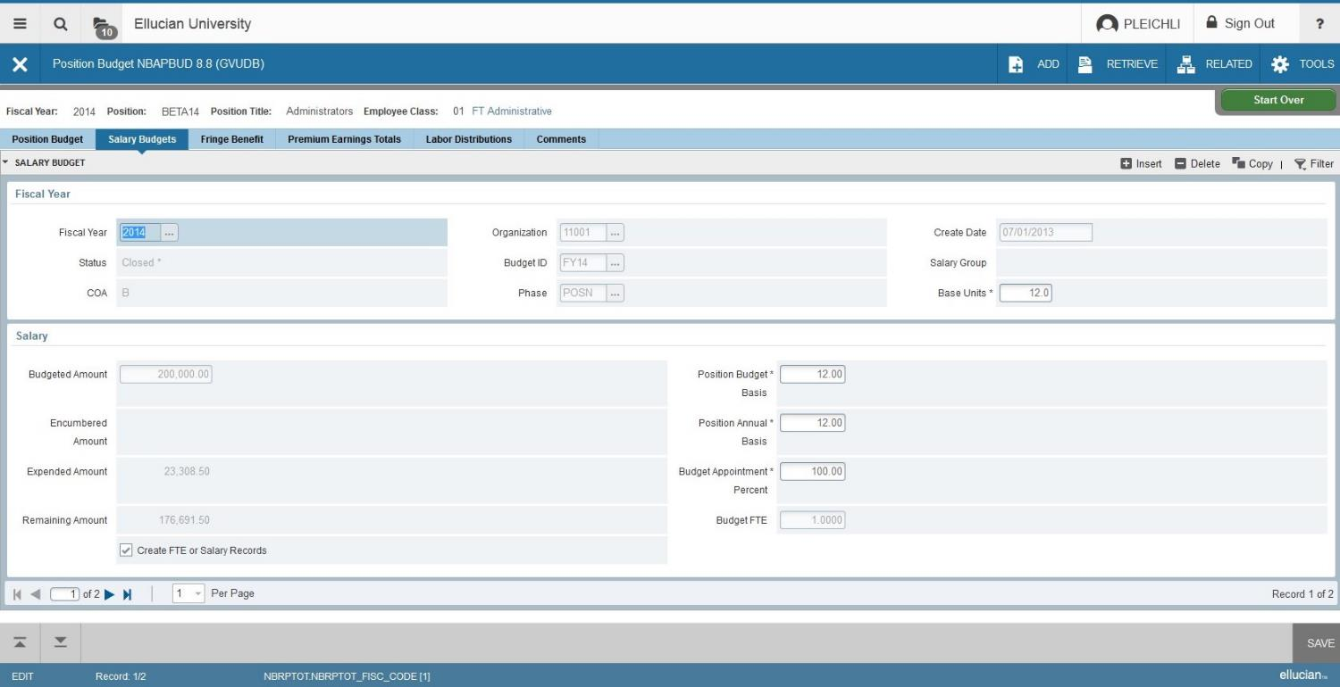
Enhanced User Interface
Standard tools and logout information.
Page navigation, total number of records and table and field information; can be used on tablet or desktop
Notes:
You can see navigational improvements with Standard tools always in the same place.
Page navigation and total # of records in the bottom left and table and field information always in the same place.

Slide 13
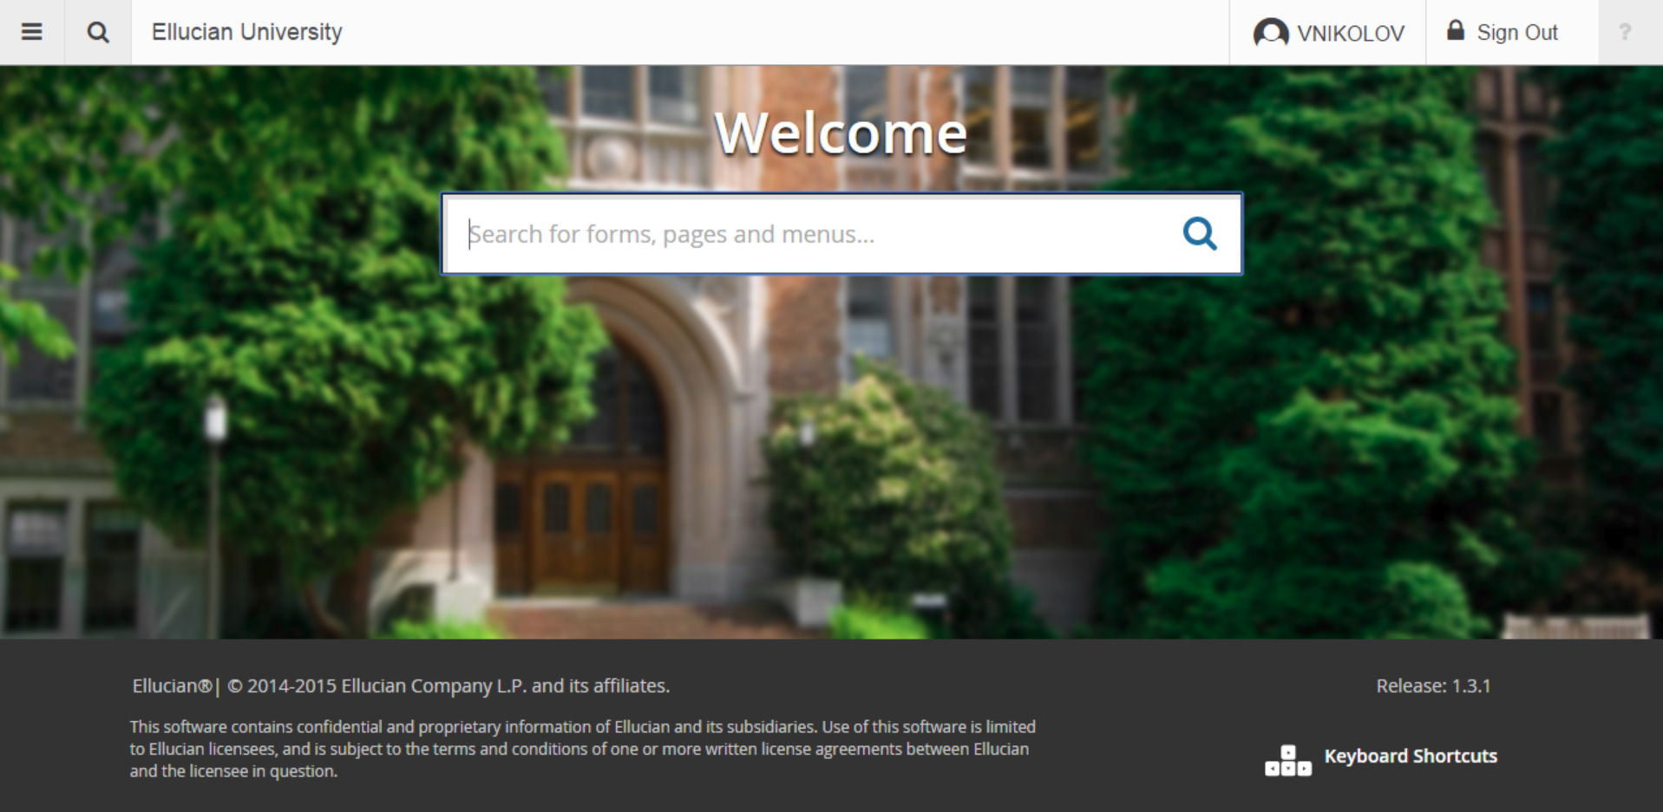
Application Navigation -
Release 9 Administrative Improvements
  Personalized Banner Admin Landing Page
Add your institution name
Search for and open new and legacy Banner forms using normal language or seven character abbreviation.
Set your own background image
Notes:
Application Navigator
Allows you to navigate between transformed Admin pages and Banner 8 forms
Ability to customize landing page

Slide 14
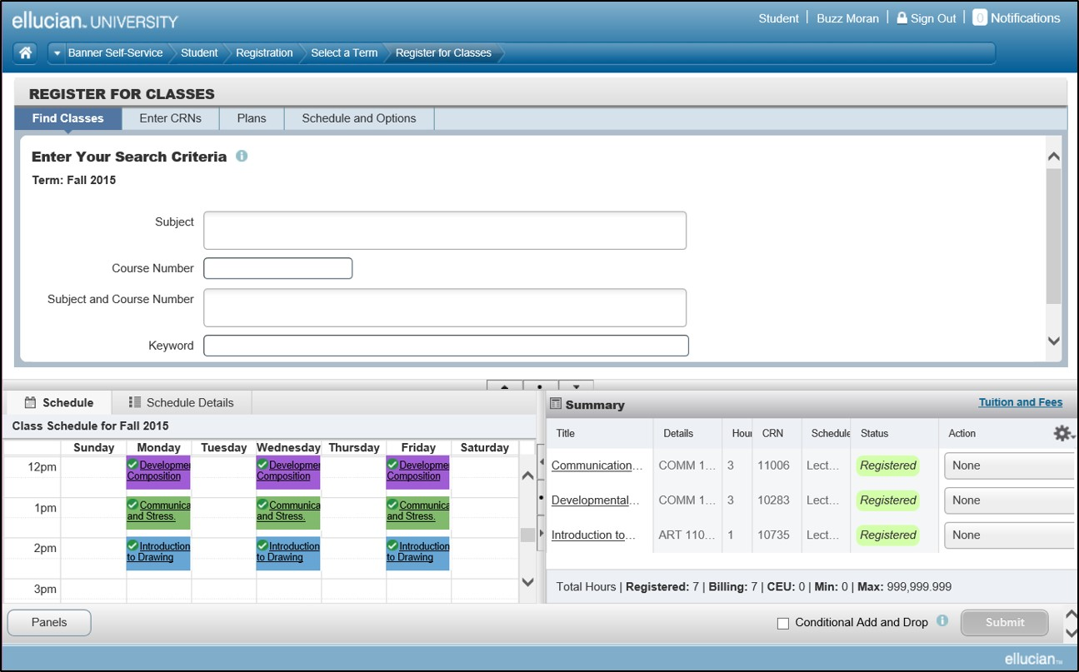
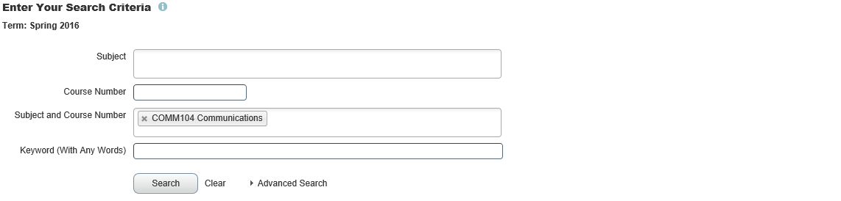
Registration
Notes:
Banner® Registration has been updated with intuitive registration tools and a mobile-friendly design to make it easier than ever for students, advisors, and administrators to use. And it now includes seamless integration with Ellucian Degree Works™, advisor access, and registration planning via Student Education Planner. These new features include:
*giving advisors the tools they need to help students plan for success
*letting the registrar’s office create demand-analysis reports so they can anticipate course demand
*delivering global capabilities that allow all Banner Student customers to plan for and track program completion.

Slide 15
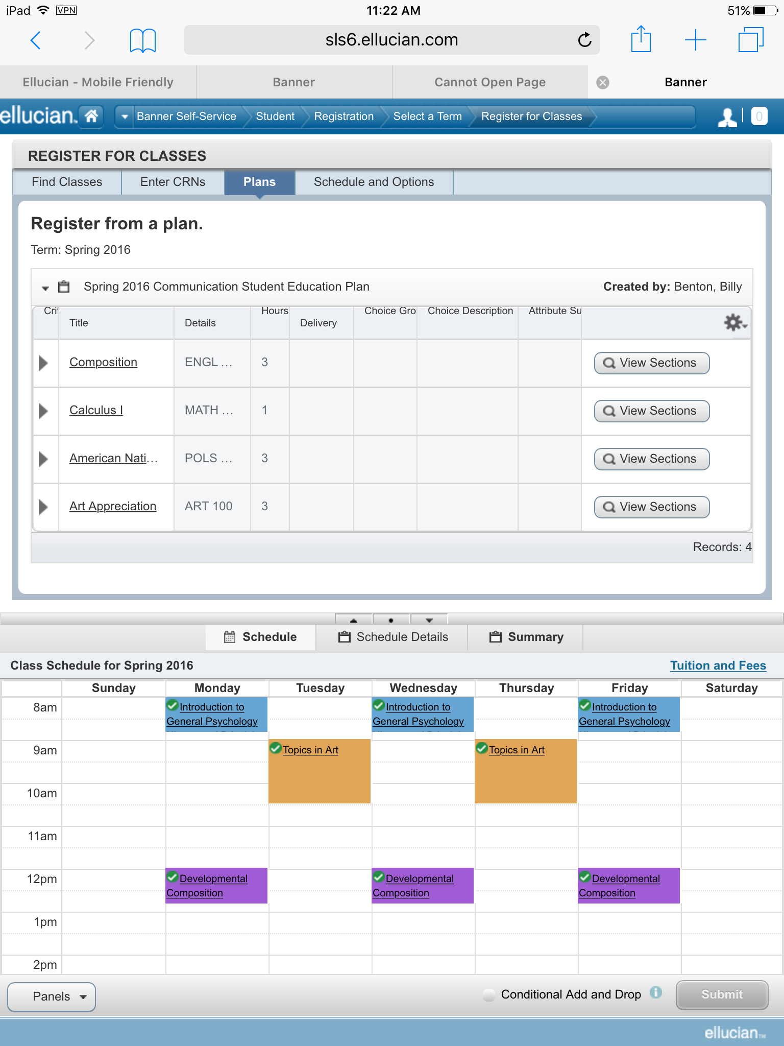
Registration
Color coded calendar
Lookup and register
for courses all on
one screen
Course details
Email schedule
Easy to read on a mobile/tablet device
One institution saw a 47 percent decrease in call volume in regards to registration issues after implementing
Notes:
With the improved Registration – your students have capabilities such as a:
Color coded calendar
The ability to lookup and register for courses all on one screen easily
Course details centralized in one place
Email schedule

Slide 16
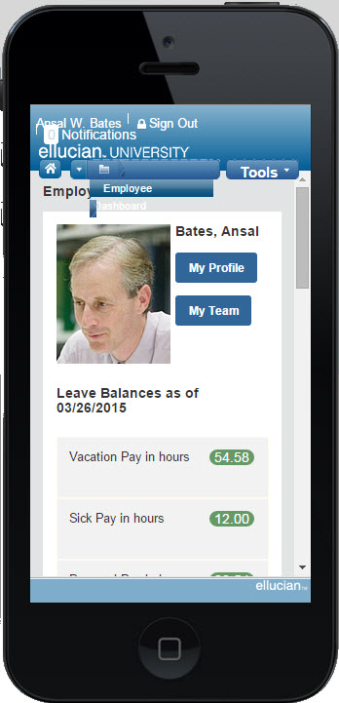
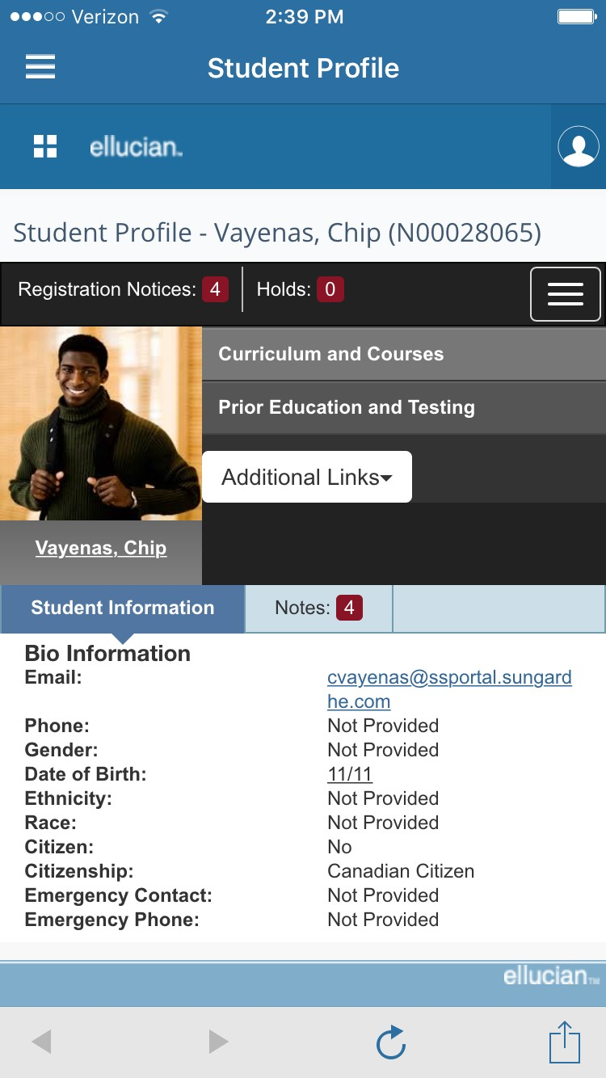
Advising and Student Profile
Advising Profile - Mobile
Combines data from 15 different Admin screens into one
Advisor, Faculty and Student see the same information
Ability to enter Notes
Links to academic transcript and degree planning
Those with appropriate privileges can update hold information
Notes:
Advising Student Profile now consolidates a student’s profile, education, and career path on a single page. And it’s newly accessible to advisors and students, allowing for truly personalized advice that helps students make better academic decisions.
You can see it:
Combines data from 15 different Admin screens into one
Advisor, Faculty and Student see the same information
There’s the ability to enter Notes
It Links to academic transcript and degree planning
Those with appropriate privileges can update hold information – (in version 9.3)

Slide 17
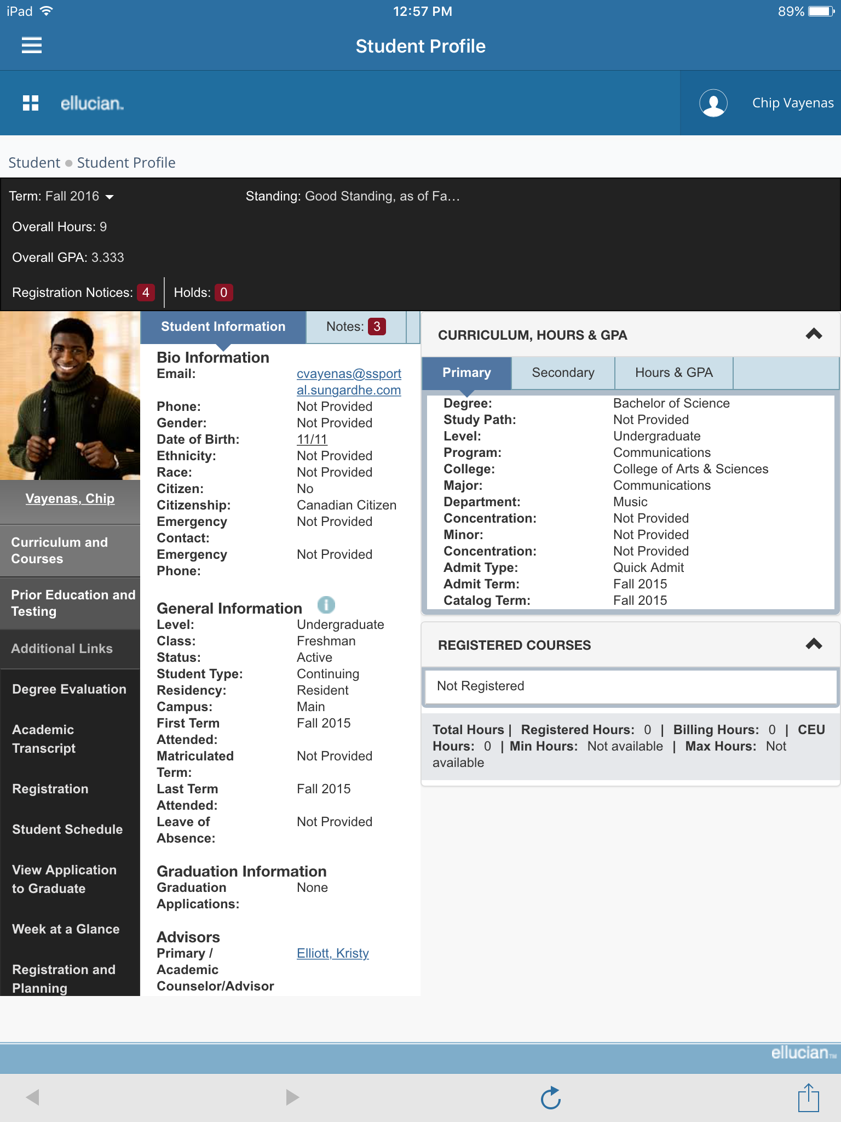
Advising and Student Profile
More Time to Advise: Tablet
After implementing one institution reclaimed 4 minutes per student per advising session to advise versus navigate through software
Time Savings:
7500 enrolled meeting w/each student only 1 time/year using the new Advising Profile could reclaim 500 advising hours (12.5 weeks) per year
Data from 15 Banner 8 forms in one responsive design page
Version 9.3 includes Hold release functionality
Notes:
This is what the advising profile looks like on a tablet. Students and advisors can see their personal information, course schedule and advising notes all from one place.
4 minutes per student multiplied by your institution’s student population. This example shows the numbers for an institution with 5500 students.

Slide 18
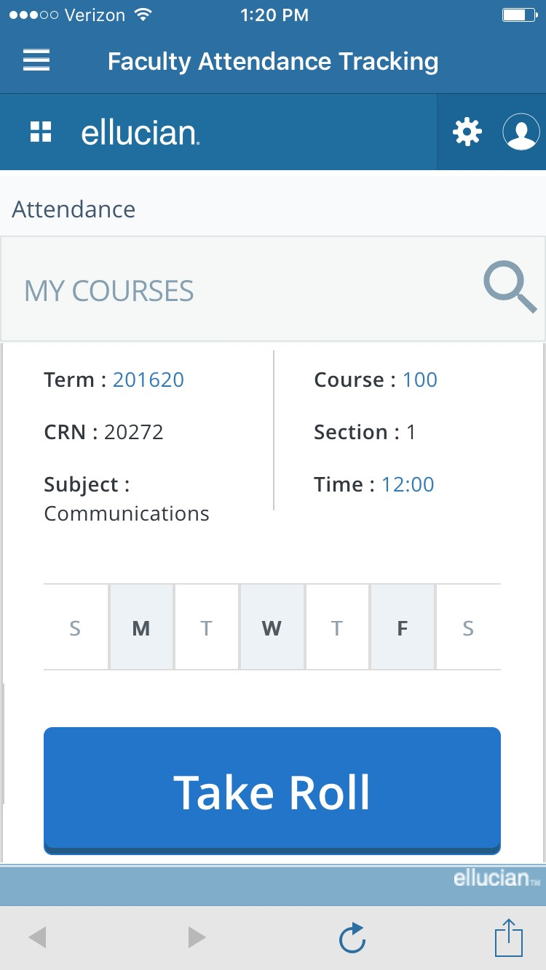
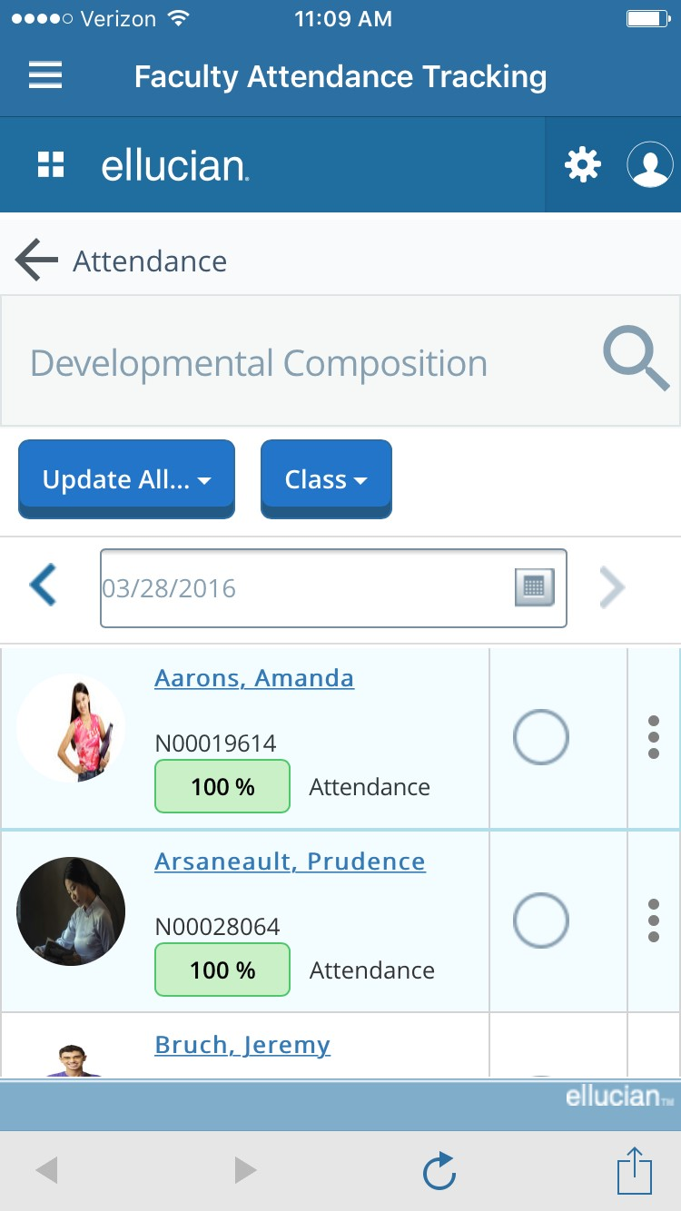
Attendance Tracking
Responsive Design
Student photos displayed
Excel Template for tracking and uploading attendance
Notes:
Attendance Tracking offers faculty members an easy, all-new tool for documenting student attendance, saving your registrar and financial aid officers time. And it can be accessed via Ellucian Mobile as an added application.
It was designed with responsive design in mind, shows the students photos and has an excel template for tracking and uploading attendance.

Slide 19
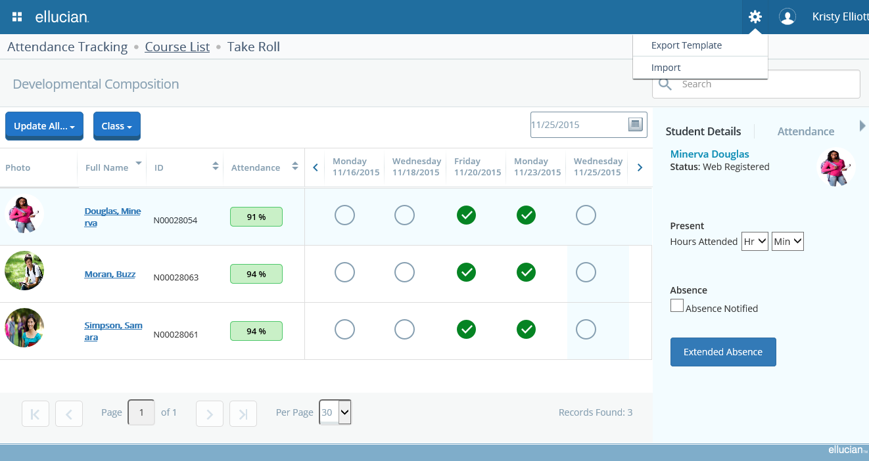
Attendance Tracking
Notes:
Here is attendance tracking on a Tablet and larger screen
Attendance Tracking offers faculty members an easy, all-new tool for documenting student attendance, saving your registrar and financial aid officers time. And it can be accessed via Ellucian Mobile as an added application.

Slide 20
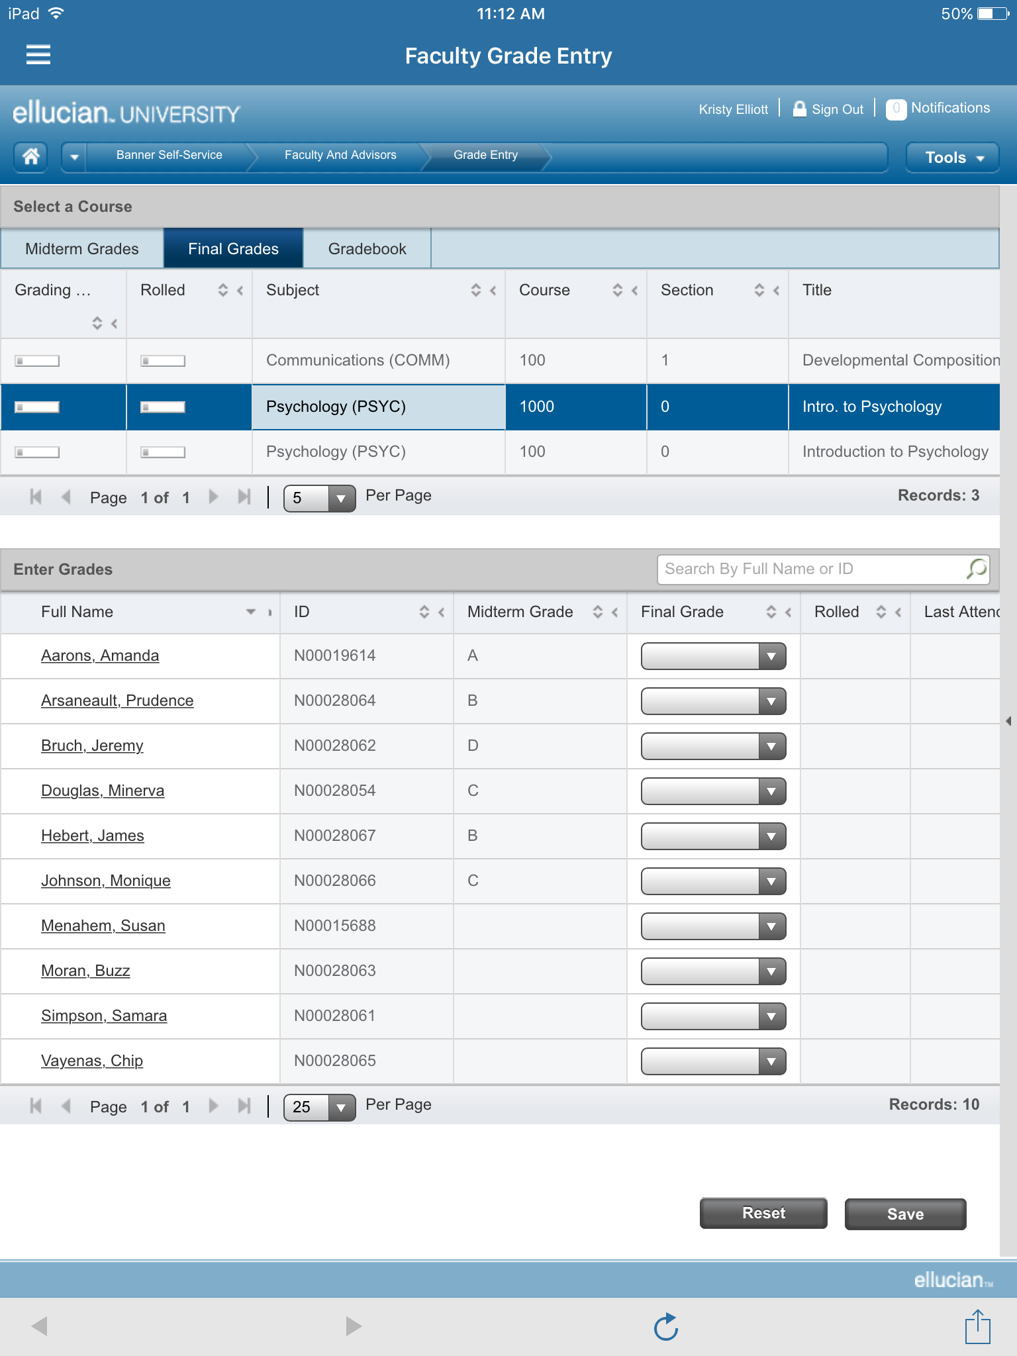
Faculty Grade Entry
Faculty Grade Entry - Tablet
Responsive Design
Student Photo displayed when student selected
Excel Template for tracking and uploading attendance
Notes:
Faculty Grade Entry was build with:
Responsive Design
Now shows faculty the Student Photo displayed when student selected
And also leverages an Excel Template for tracking and uploading attendance

Slide 21
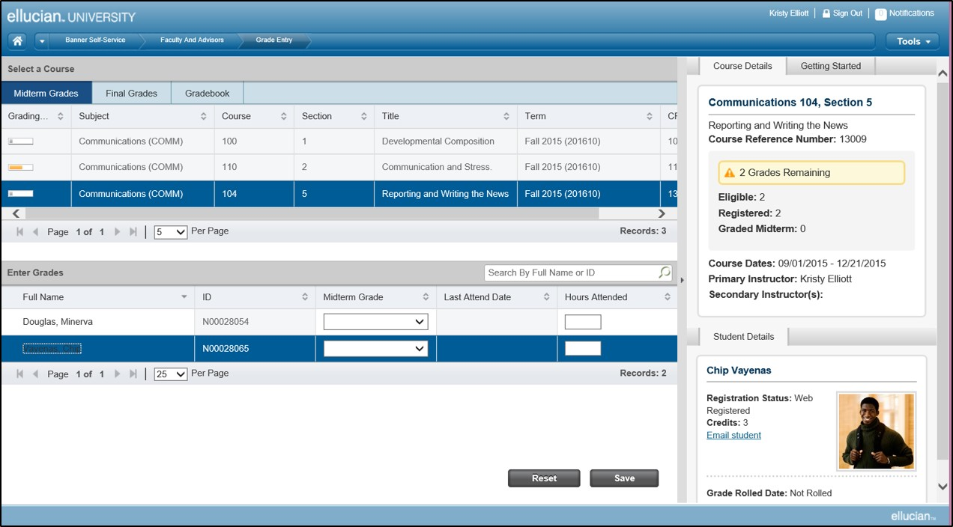
Faculty Grade Entry
Notes:
Tablet and larger screen
Faculty Grade Entry now offers faculty members mobile capability for entering assignment grades and posting midterm, final, and incomplete grades. The application can then automatically compute a final grade. To make things even easier, faculty members can also import grades directly from their existing spreadsheets or their learning management system.

Slide 22
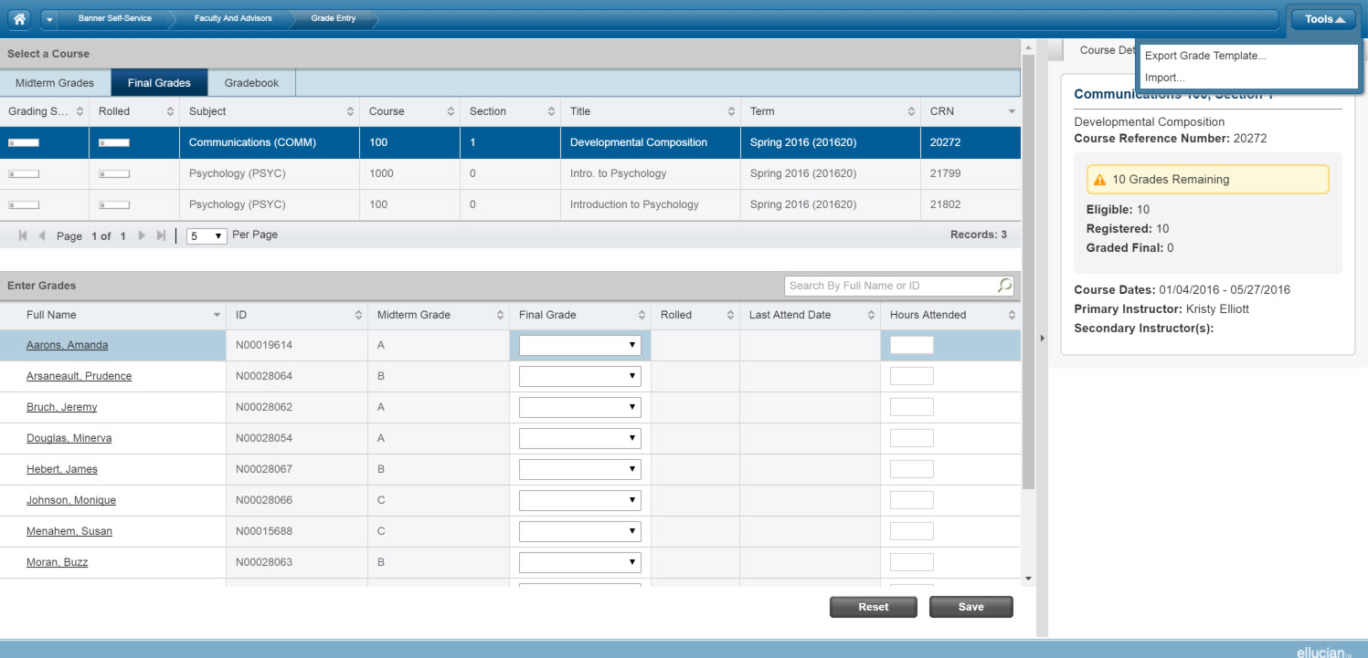
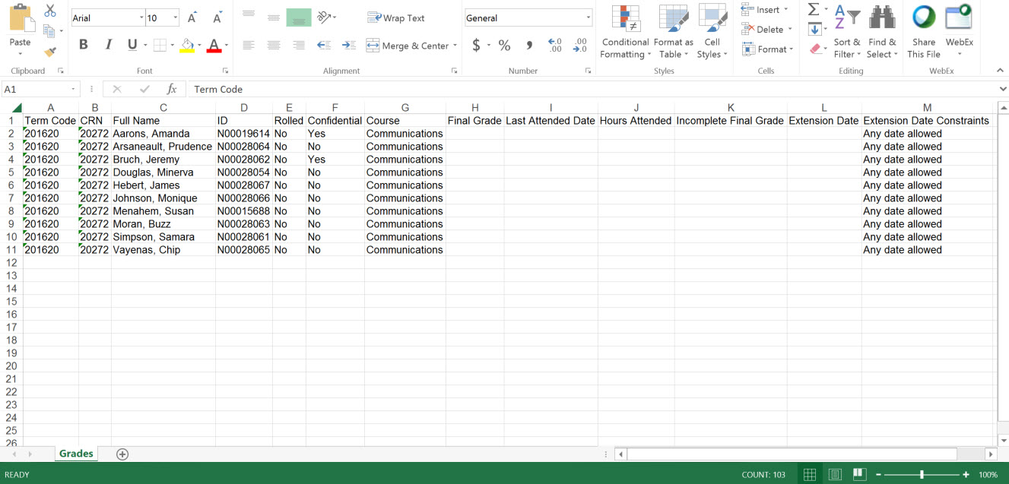
Faculty Grade Entry
Notes:
This is the new Faculty Grade Entry application. It provides faculty with the ability to enter grades through a scalable user interface, or they can download an excel template file, track grades in that, and upload those grades throughout the semester.
It also gives them the ability to see student photos and email their students right from the grading module.
Tablet and larger screen

Slide 23
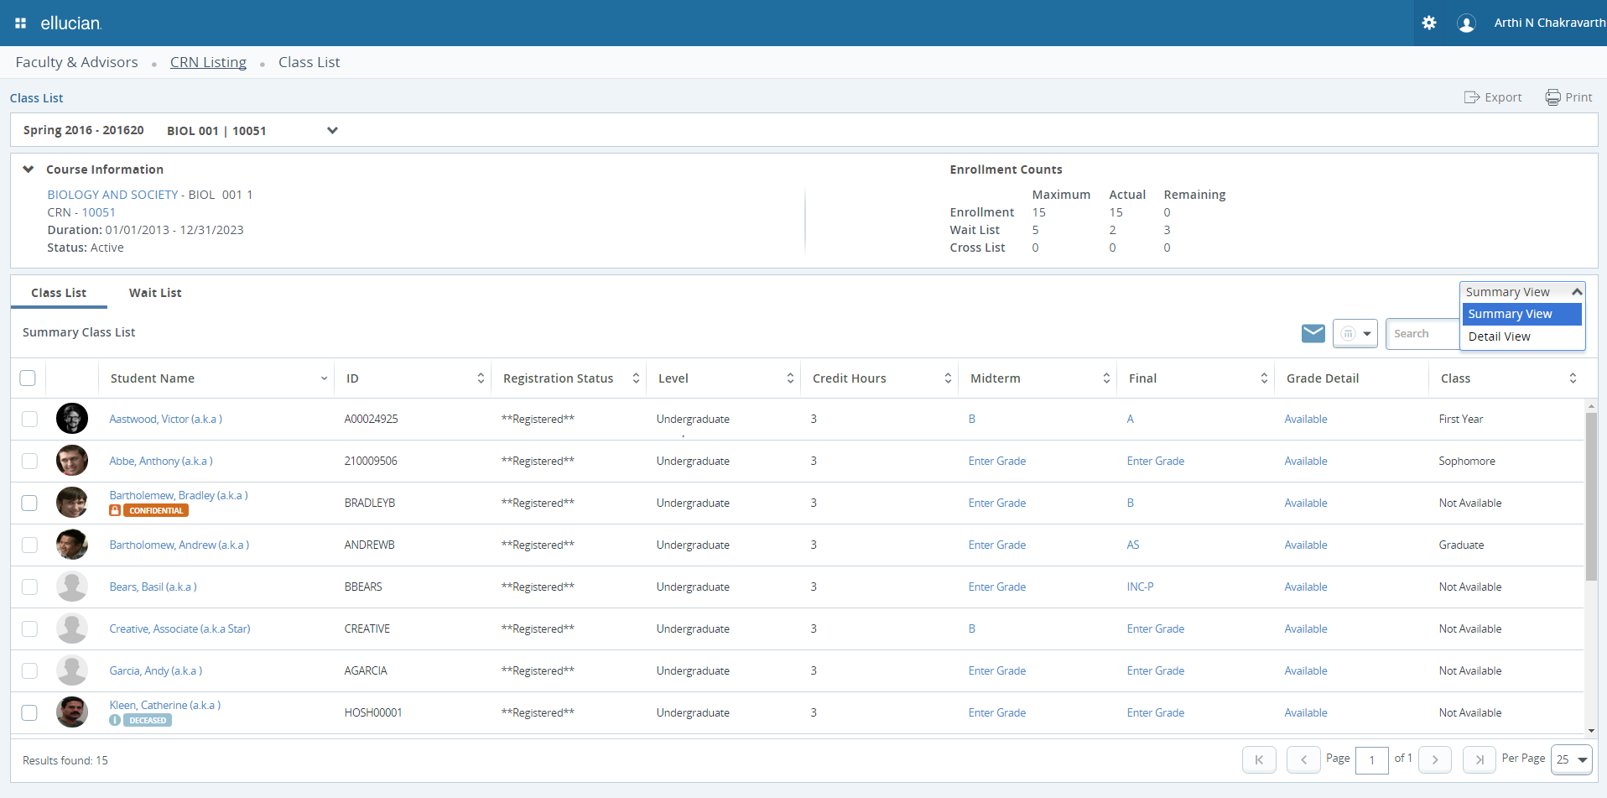
Class Roster
Notes:
Student Self-Service now includes Class Roster and View Grades functionalities:
Class Roster lets faculty members review their students’ academic profiles and schedules, communicate with students over email, print class rosters, and more.
View Grades lets faculty members, students, and their advisors view a student’s academic progress.

Slide 24
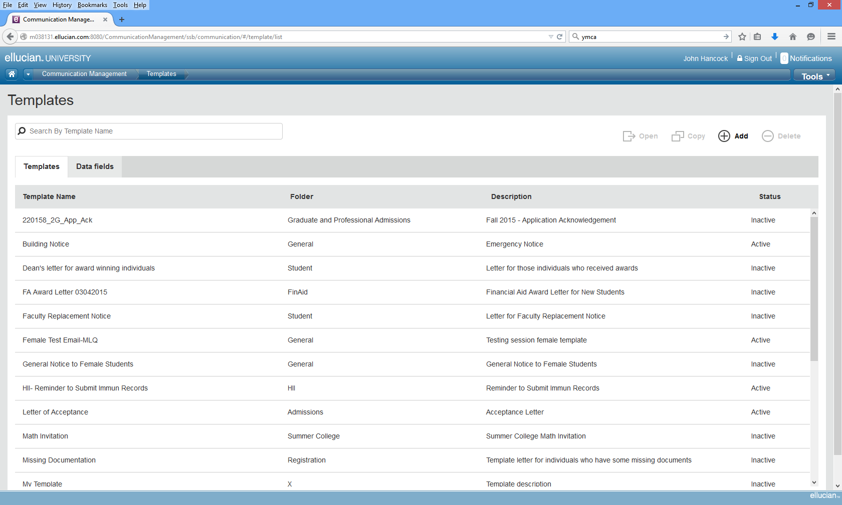
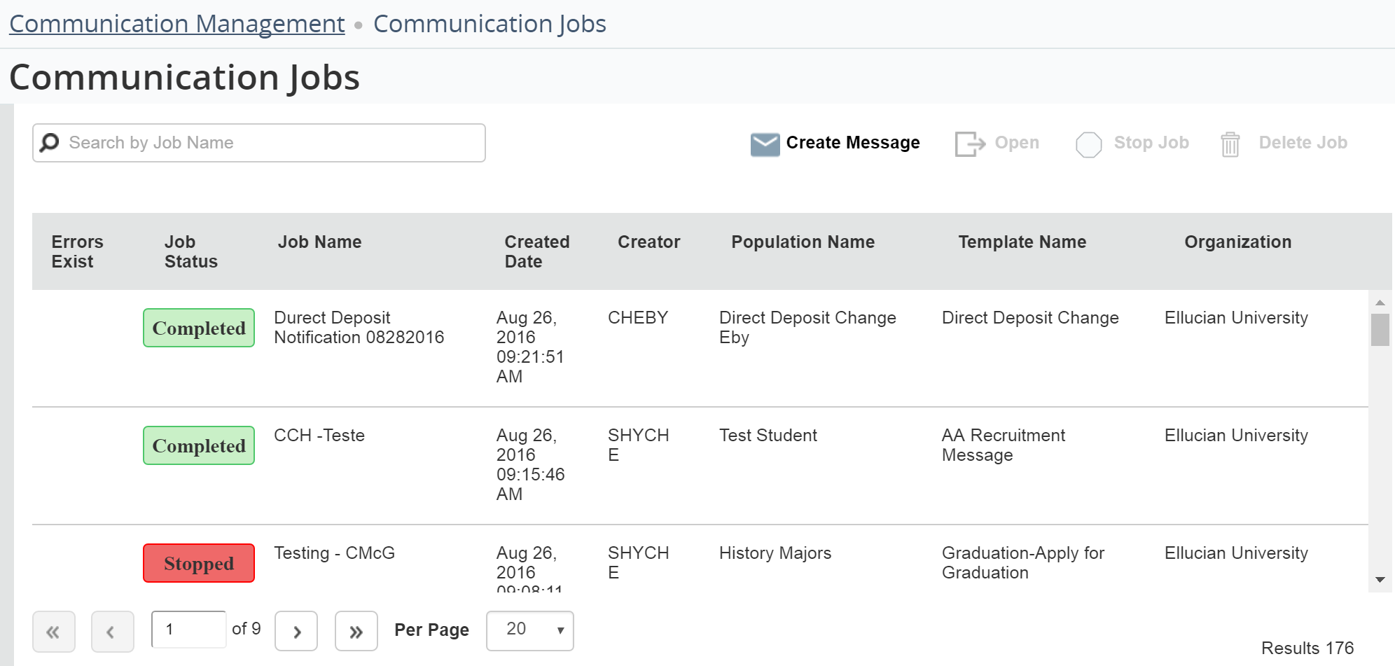
Communication Management
Key Features:
Features work across the Banner enterprise
Manages transactional connections to your constituents using Banner data
Set notifications or reminders to register for classes or when tuition is past due
Notes:
Communication management is a brand new functionality folks are really excited about.
Communication Management offers all-new tools to helps you communicate with specific populations using Banner data. Communication Management makes it easy to create and send financial aid award letters, registration reminders, past-due tuition notices, and more.
It’s part of Banner General. It works across the entire Banner enterprise. You can communicate with any
Tactical and operational communications. It’s not a strategic communication platform but rather a process oriented platform. Communications you’d send to a subset of people like: “Your bill is due.” “You need to register.” “It’s time for benefits elections”

Slide 25

Expanding Banner 9 Functionality
Personal Information Self-Service
  View, edit and update biographic and demographic information
  Will display first/middle/last and preferred name in Personal Details, yet support name display differently in Overview section
  Configurable using the Integration Configuration Settings (GORICCR) page
  Direct Deposit and Personal Information functionality merged into single application
  Easier to update and configure, by institution
Notes:
The functionality for Personal Information Self-Service has expanded.
You now can:
View, edit and update biographic and demographic information
Display a name in Personal Details (for the first, middle, last or preferred), yet support name display differently in Overview section
Configure the Integration Configuration Settings (GORICCR) page to your preference
Direct Deposit and Personal Information function has now merged into single application
It is overall easier to update and configure, by institution

Slide 26
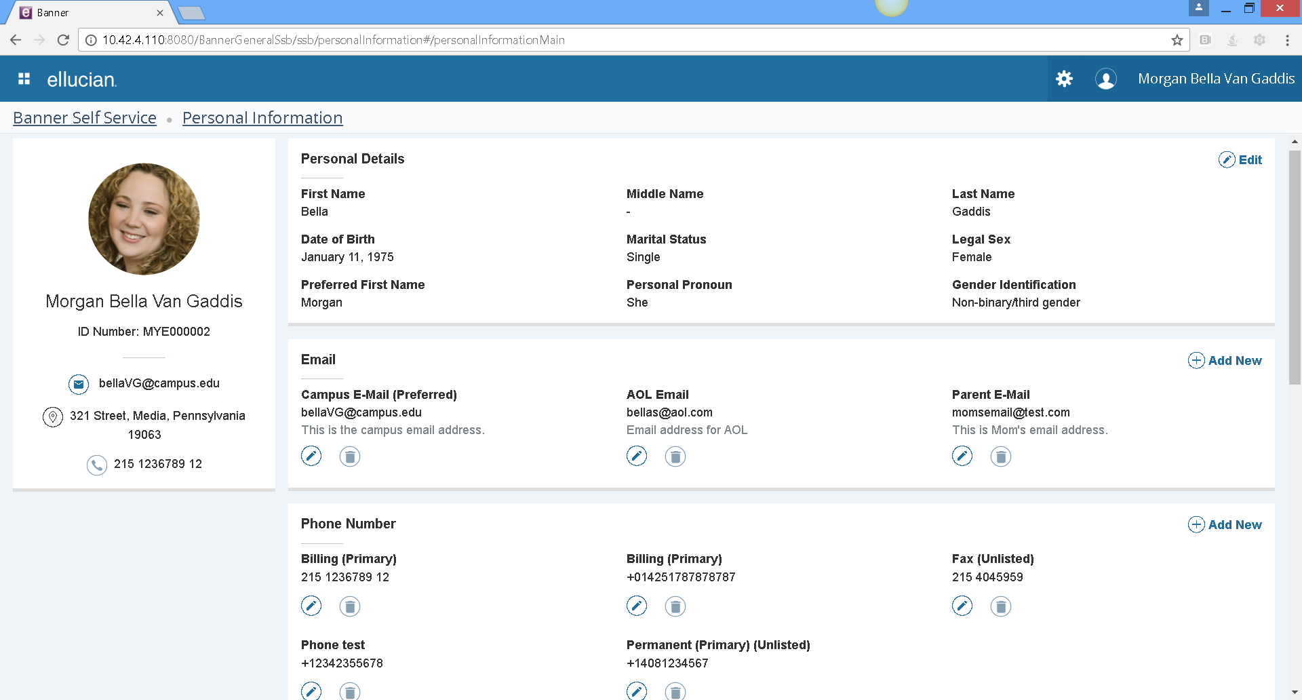
Personal Information Self-Service

Slide 27
What we’ve heard . . .
“The moment that I was able to sort on sequence number, then have the ability to replace the sequence numbers and save in one transaction, it was as if a light shined over my monitor with a faint chorus in the background. I was thrilled to see that improvement.”
Stephanie Boledovich, HR Systems Manager, Lansing Community College
“Employee Profile is a modern way of letting employees look at their own data and do their job and they can take it anywhere, because it is configured to work on any device – laptop, tablet and smartphone. Well done Ellucian! I love it. It is so easy to set up even a cave man can do it.”
Ali Penton, Software Application Engineer, University of West Florida
More stories on eCommunities
“We went actually live with Registration for our early registration for the following summer classes and it proved flawless. It worked with no problems and every review we’ve had has been positive.”
-Delano Sweeney, Database Systems Manager,
Bluefield State College

Slide 28
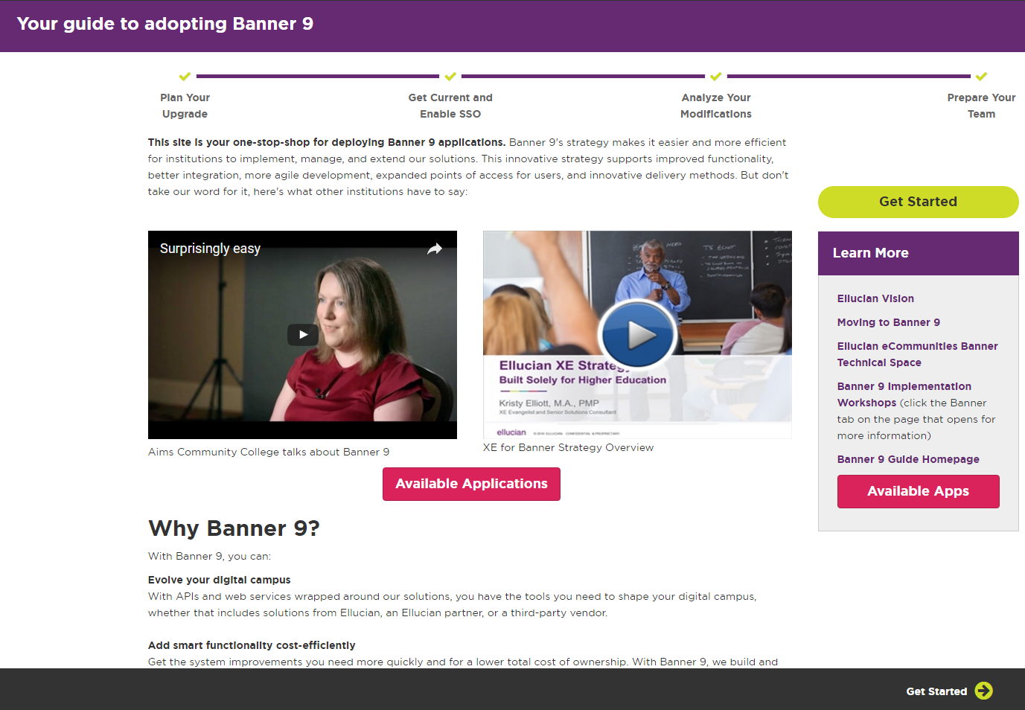
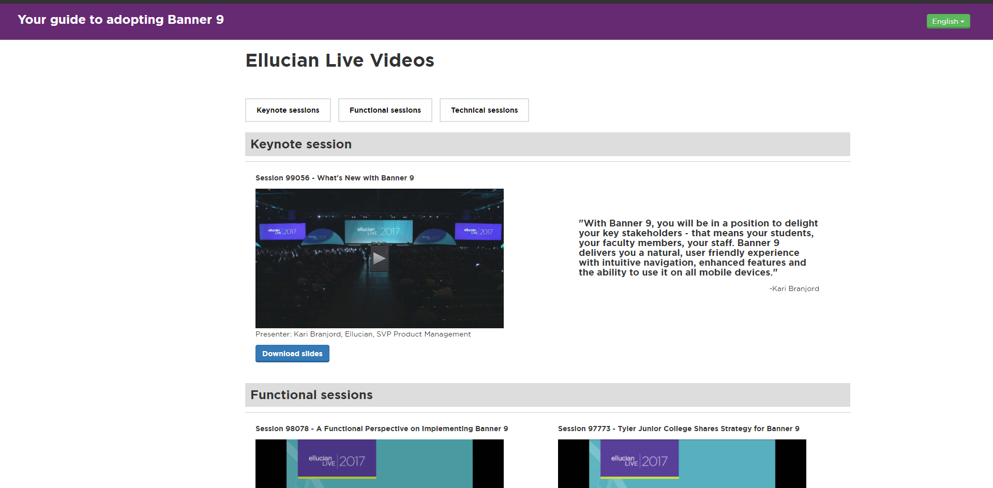
Banner 9 Guide at www.ellucian.com/banner9guide
See Ellucian Live videos on Banner 9 https://banner9guide.ellucian.com/content/ellucian-live-videos
Notes:
One primary resource is the Banner 9 Guide, which can be found online at ellucian.com/banner9guide
This site will continue to be your one stop shop for Banner 9 Upgrade content, so please ensure you have a HUB account and check back here as needed.

Slide 29

Places to Find More Information
Demos
Admin – Student
Admin – Financial Aid
Admin – Student Aid
Self Service - Advising Student Profile
Self Service – Student Profile
eCommunities
  Banner user community - Global Search feature that now pulls from eCommunities, the Ellucian Support Center and the Ellucian.com website
Attend an Ellucian education class
Notes:
Some great resources to check out.

